Slide 1

Prototyping and Tests in design thinking
IPAI 2024
Master SDIA, University of Constantine
Pr. Layeb

Slide 2
Prototyping: Introduction
Prototyping plays a pivotal role in the design process, serving as a concrete representation of ideas and facilitating communication between designers, stakeholders, and end-users.
Visualization: Prototypes bring concepts to life, allowing stakeholders to visualize and interact with a design before full-scale development.
User Feedback: Early prototypes enable designers to gather valuable feedback from users, informing iterations and improvements.
Risk Reduction: Identifying and addressing design flaws early in the process reduces the risk of costly errors during later stages of development.
Communication Tool: Prototypes serve as a shared language, helping designers, developers, and stakeholders align on the vision and functionality of a product.
Iterative Improvement: An iterative prototyping process allows for continuous refinement based on feedback, ensuring the final product meets user needs effectively.

Slide 3
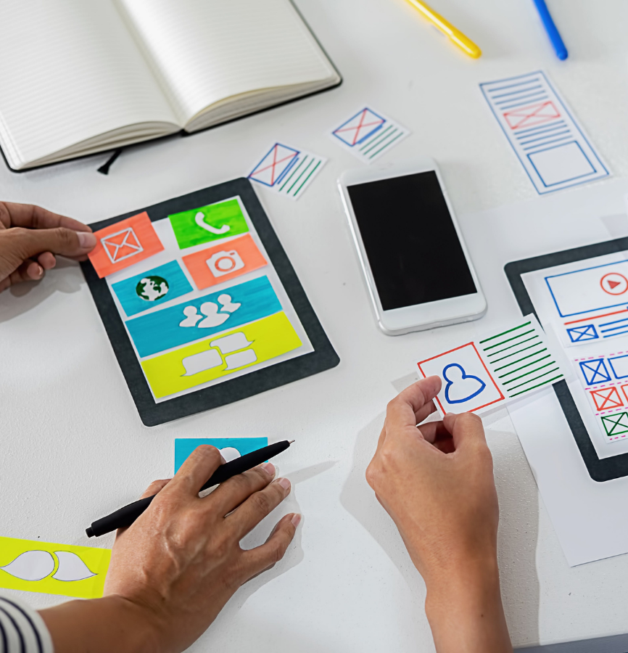
Types of prototypes
Low-fidelity prototypes
Simple prototypes, called low-fidelity, are fast and cheap to make.
These can be sketches on paper or quick digital drawings. Although they may not be detailed or polished, they are easy and quick to create.
If you're starting the design process and think you'll be making a lot of changes, a lo-fi prototype helps you get a basic idea without spending a lot of time.

Slide 4
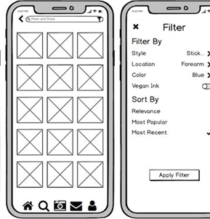
Types of prototypes
Mid-fidelity digital prototypes
If you're aiming for a quicker and clearer representation of the final design, consider mid-fi prototypes.
Fast and easy to create, with a range of free tools at your disposal.
Achieve the right equilibrium between detail and speed with mid-fi prototypes.
Similar to lo-fi, they display essential elements while enabling realistic app navigation
Various elements arranged similarly to the final design.
Frequently placeholders or templates, including images and text on each screen.

Slide 5
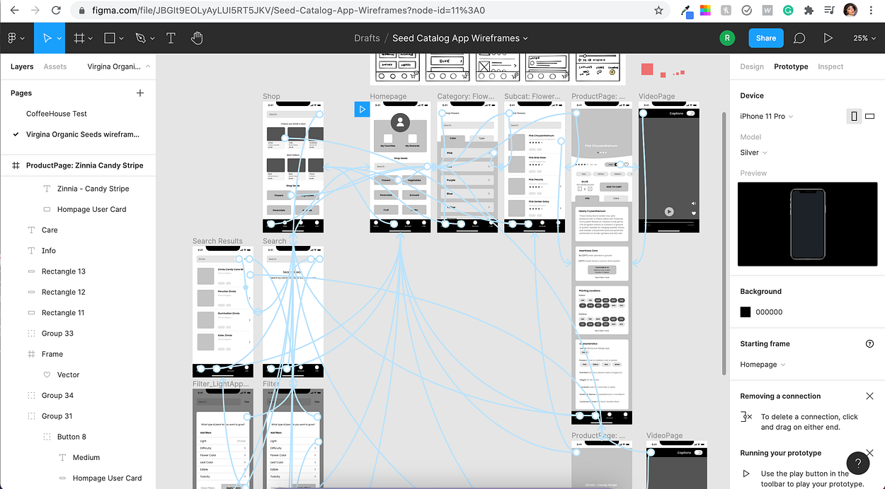
Mid-fidelity digital prototypes with Figma

Slide 6
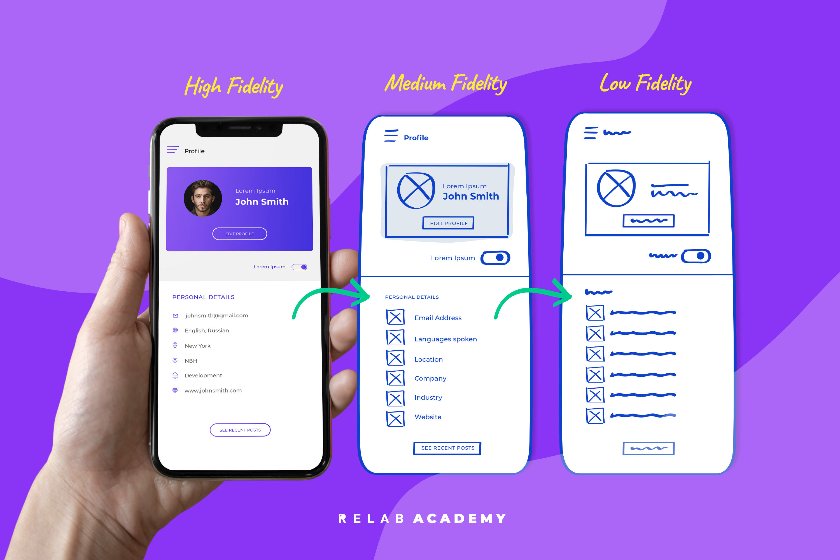
Types of prototypes
High-fidelity prototypes
These prototypes take more time and effort to create because they aim to closely resemble the final product.
Similar to mid-fi prototypes, hi-fi ones allow users to navigate through an app, but with a level of detail that mimics using the actual product, showing how it will look when it's finished.

Slide 7
Testing
Determine Your Testing Goals: Decide what you want to find out through testing. Are you checking user interest, preferences, or usability?
Choose Testing Format and Method: Select the format (in-person or remote) and method (moderated or unmoderated) that suits your needs. Concepts like A/B testing and usability testing will be discussed further.
Define Success Measures: Decide how you'll measure the success of the test, depending on the method you choose.
Create Testing Tasks: Develop tasks for users to perform with the prototype. It could be asking for their impressions or having them complete specific tasks.
Recruit Users: Find users for testing. This could be done in-house or with external help, ensuring a diverse group of participants.
Conduct the Test: Observe how users interact with your design, focusing on functionality and user experience.
Debrief and Analyze: Review the results. What did users say and do? Summarize the findings.

Slide 8
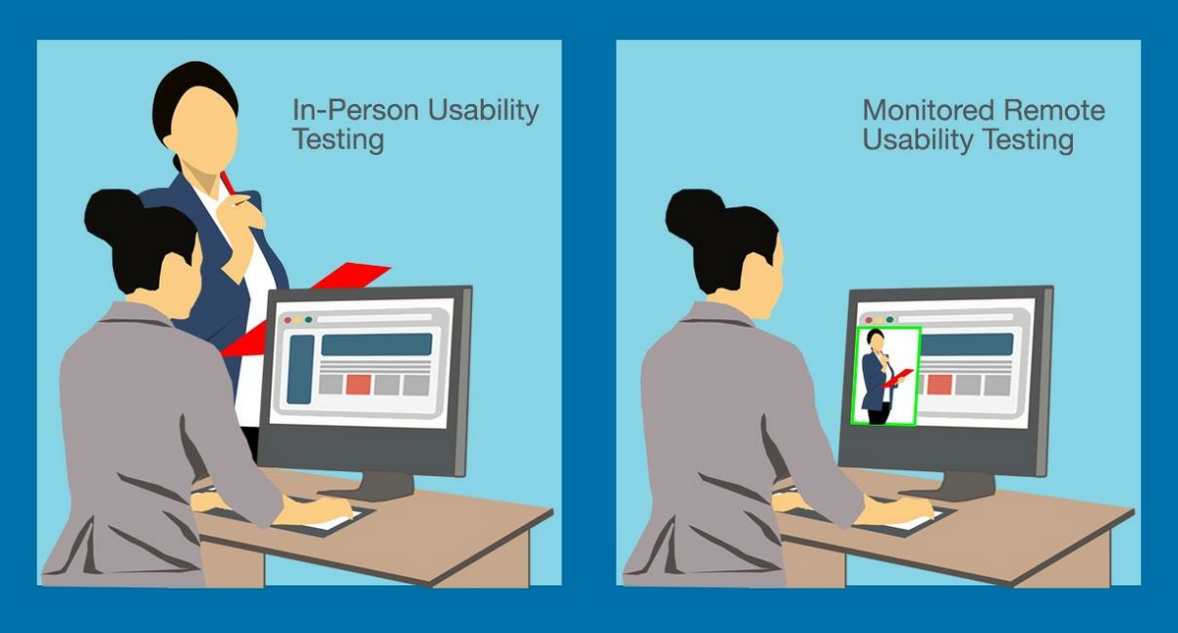
types of user testing
In-person vs. remote
In-Person User Testing: Requires users to visit a specific location to test your prototype. It can be costly and time-consuming, but it offers control over the testing environment. You can observe facial expressions, body language, and interpersonal nuances.
Remote User Testing: More affordable and less time-consuming, users can test the prototype from their own locations. However, you lose control over the testing environment.

Slide 9
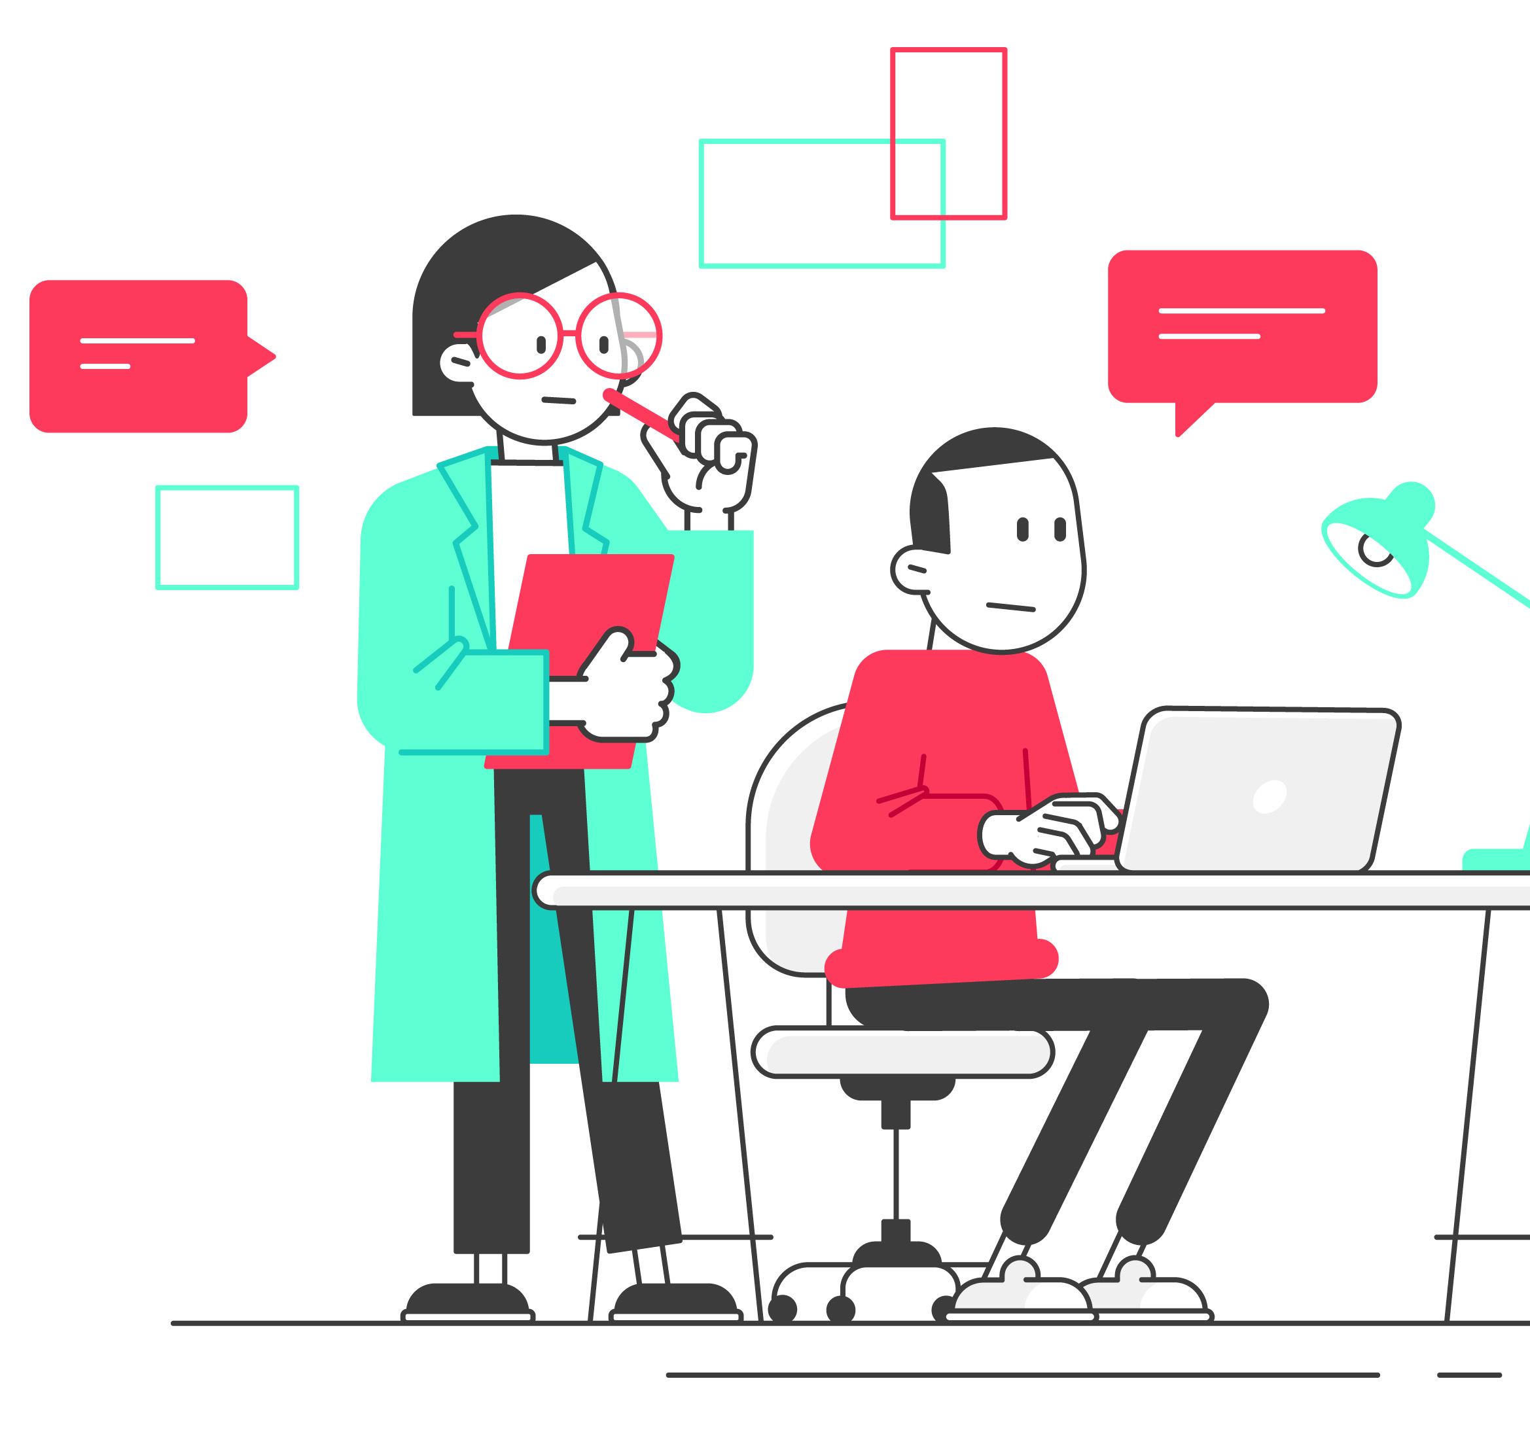
types of user testing
Moderated vs. unmoderated
Moderated User Testing: Conducted with you or your team present, guiding or observing users during the prototype test. Similar to in-person testing, it allows for real-time observation and interaction but can be time-consuming and costly.
Unmoderated User Testing: Users complete the testing task without your presence. While it's less time-consuming and simpler, you can't ask questions in real-time, although you can record comments, reactions, and expressions for later analysis.

Slide 10
User testing methods
Concept testing
A/B testing
Usability testing

Slide 11

Concept testing
Purpose: Conducted early in the design process to test multiple ideas for solving the same problem and determine which is most valuable to users.
Method: Typically involves a qualitative survey where users provide feedback on their preferences and motivations for liking or disliking a particular idea.
Benefits: Helps explore the viability of an idea early on, although it may challenge your favorite concept. Provides qualitative insights into users' thoughts and feelings.

Slide 12
A/B testing
Purpose: Conducted when you already have a prototype and want to test specific elements or variations to determine which is more effective.
Method: Involves testing two versions (A and B) of the prototype with different elements, and measuring the success based on quantitative data.
Example: Testing variations of a home screen layout to see which version engages users more.

Slide 13
Usability testing
Purpose: Essential for effective design, focusing on evaluating the usability of a product with real users.
Feasibility: While not feasible for this course, usability testing is crucial for thinking designers working with mid- to high-fidelity prototypes.
Importance: Understanding usability is integral to being a thinking designer, ensuring that the design is user-friendly and meets users' needs.

Slide 14
Usability testing process
Plan Your Test:
Define the usability heuristics you want to measure.
Develop effective usability testing questions.
Recruit Test Participants:
Aim for a minimum of five participants.
Represent a diverse range of backgrounds, identities, and life experiences.
Schedule and Run the Tests:
Conduct tests in-person or remotely.
Ensure participants feel at ease and provide clear instructions and questions.
Use various observation and interaction methods.
Analyze the Results:
Gather both qualitative and quantitative data from the testing sessions.
Synthesize and present the results for your own understanding and for collaboration with team members or stakeholders.

Slide 15
conclusion
Design is an ongoing, cyclical process.
Continuous testing and refinement are essential for success.
Iteration leads to improved user experiences and design solutions.

